Slide 1

Chapter 3 The Karnaugh Map
A graphic approach to simplify any function
No guarantee of finding a minimum solution; sum of product and product of sum
Definitions
Boolean function f(x) : B^{n} → B
f(x) : {0,1} ^{n} →{0,1}
letter : a constant or a variable
literal : a letter or its complement
  EX) B = {0,1}, variable : x₁, x₂
  letter : x₁, x₂, 0, 1
  literal : x₁, x₂, 0, 1, x₁’, x₂’
3 - <number>

Slide 2
Review on product and sum term
Product term (product, term)
  1
  a non-constant literal
  a conjunction of non-constant literals where no letter appears more than once
  1, x₁, x₁’x₂ , x₁x₂ x₁’ (X), x₁+x₂’ (X)
Sum term
  0
  a non-constant literal
  a disjunction of non-constant literals where no letter appears more than once
  0, x₁, x₁+x₂’ , x₁’ x₂ (X), x₁+x₂+ x₁’ (X)
3 - <number>

Slide 3
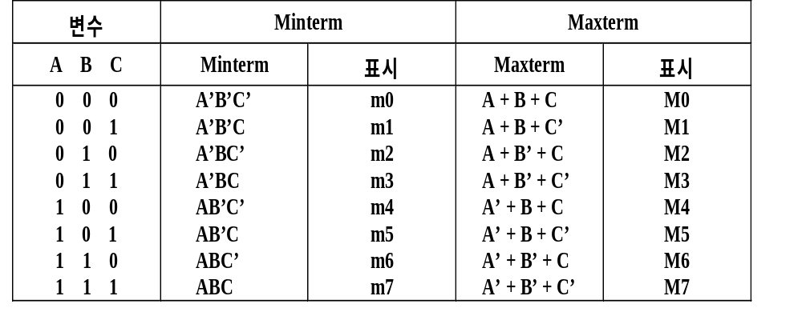
Minterm and Maxterm
Minterm
  : 모든 변수가 항상 한번씩 사용된 product term(곱항)
  Ex) 변수 : X, Y, Z
  X’YZ, XYZ’, XYZ, X’Y’Z’, XY (X), X’Z (X)
Maxterm
  : 모든 변수가 항상 한번씩 사용된 sum term(합항)
  Ex) 변수 : X, Y, Z
  X+Y+Z, X’+Y+Z’, X’+Y’+Z’, X’+YZ (X), X+Z’ (X)
Ex) 3개의 변수에 대한 Minterm 과 Maxterm
3 - <number>

Slide 4
Boolean function
Sum of product (SOP), disjunctive normal form (DNF), ΣΠ
  f = x₁x₂’ + x₂ ’x₃ + x₁x₃’
Product of sum (POS), conjunctive normal form (CNF), ΠΣ
  f = (x₁+ x₂ ’)(x₂ + x₃ )(x₃ + x₁)
Canonical sum of product : sum of minterms
  f(A,B,C) = A’B’C + A’BC + AB’C + ABC
  = m₁ + m₃ + m₅ + m₇
  = Σ (1, 3, 5, 7)
Canonical product of sum : product of maxterms
  f(A,B,C) = (A+B+C)(A+B’+C)(A’+B+C)(A’+B’+C)
  = M₀ M₂ M₄ M₆
  = Π (0, 2, 4, 6)
3 - <number>

Slide 5
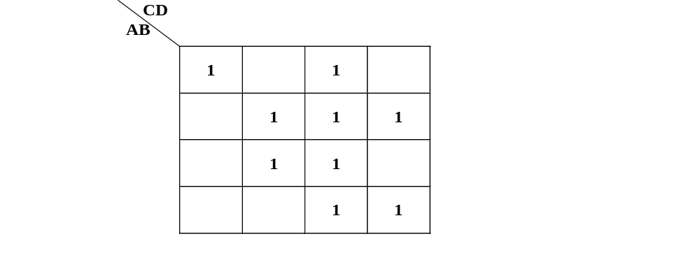

Karnaugh Map (1953. NOV)
F(A,B,C,D) = A’B’C’D’+A’BC+AB’C+BD+CD (SOP)
= Σ (0,3,5,6,7,10,11,13,15) canonical SOP
Implicant : 2^{k} 개의 1의 묶음
Prime Implicant : 더 큰 묶음(Implicant)에 포함되지 않는 묶음
Essential Prime Implicant
  하나의 prime Implicant를 형성하고 있는 1 들 중에서 적어도 하나는 다른 Implicant에 속하지 않고 자신의 Prime Implicant 묶음에만 속하는 Prime Implicant
간략화된 함수에는
  E.P.I 전부와 non-essential P.I 일부 포함
3 - <number>

Slide 6
Karnaugh Map
Implicant
  : a product term p that is included in the function f (p ≤ f)
  Ex) f = xy’ + yz, xy’ (PI), xyz
PI (Prime Implicant)
  : an implicant that is not included in any other implicant of f (canot be combined with another term to eliminate a variable)
EPI (Essential Prime Implicant)
  : a PI which includes a minterm that is not included in any other P.I.
A
BC
0
1
00
01
11
10
F = BC + AC’ + ( + AB)
1
PI PI PI
EPI
1 1
1
3 - <number>

Slide 7
Optimization Algorithm
Find all prime implicants.
Include all essential prime implicants in the solution
Select a minimum cost set of non-essential prime implicants to cover all minterms not yet covered:
  Obtaining an optimum solution: See Reading Supplement - More on Optimization
  Obtaining a good simplified solution: Use the Selection Rule
3 - <number>

Slide 8
Karnaugh Map
COMBINE WITH 0S
SUM-OF-PRODUCT F’
THEN COMPLEMENT
COMBINE
WITH 1S
K-MAP
NAND-NAND
AND-OR
NOR-NOR
AND-OR
PRODUCT
SUM-OF-PRODUCT
PRODUCT-OF-SUM
SUM
3 - <number>

Slide 9
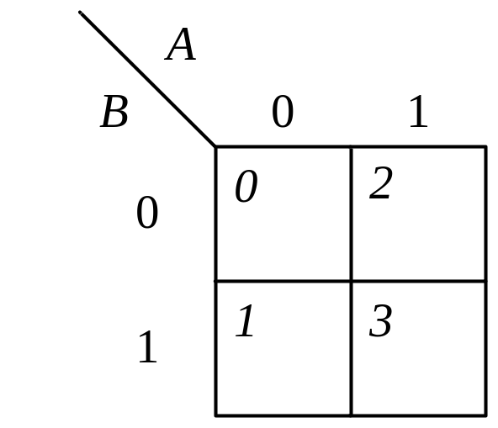
2 variable map
A
A’B’ | A B’
A’B | A B
m₀ | m₂
m₁ | m₀₃
B
3 - <number>

Slide 10
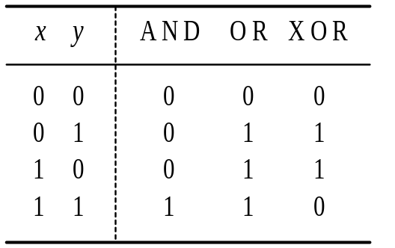
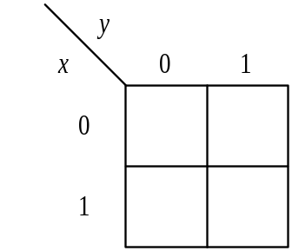
2 variable map example
1
(a) Truth table
(b) AND: xy
1
1
1
1
1
(c) OR: x + y
(d) XOR: x’y + xy’
3 - <number>

Slide 11
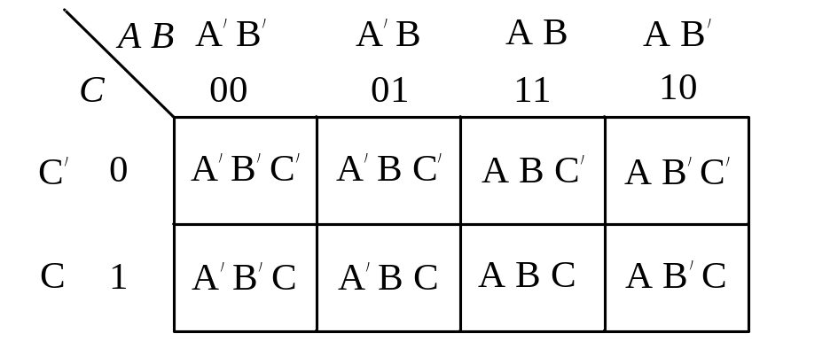
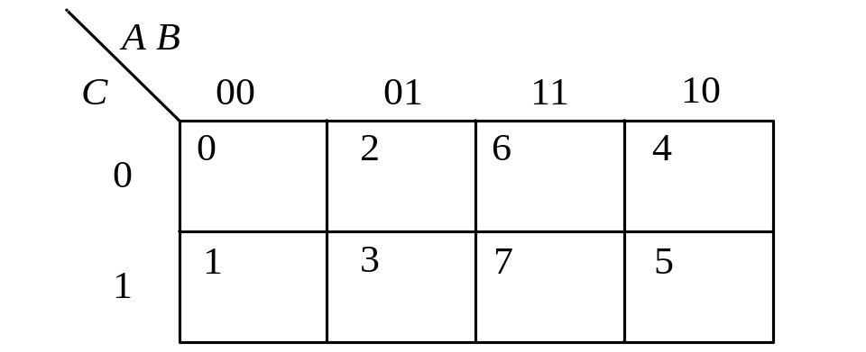

Three-variable Maps
3 - <number>

Slide 12
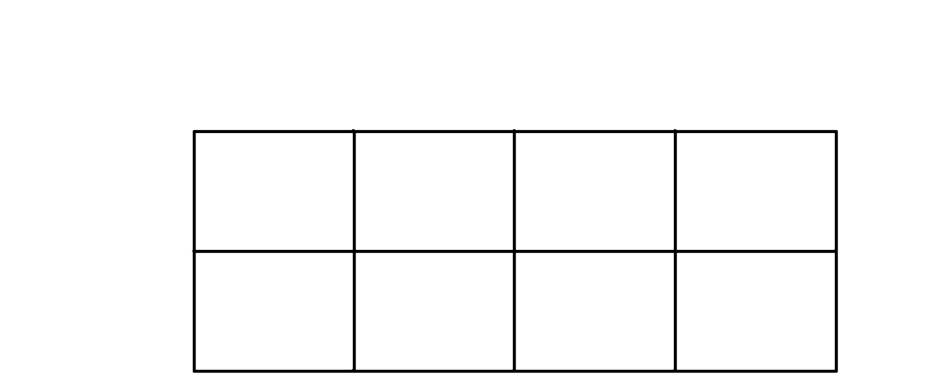
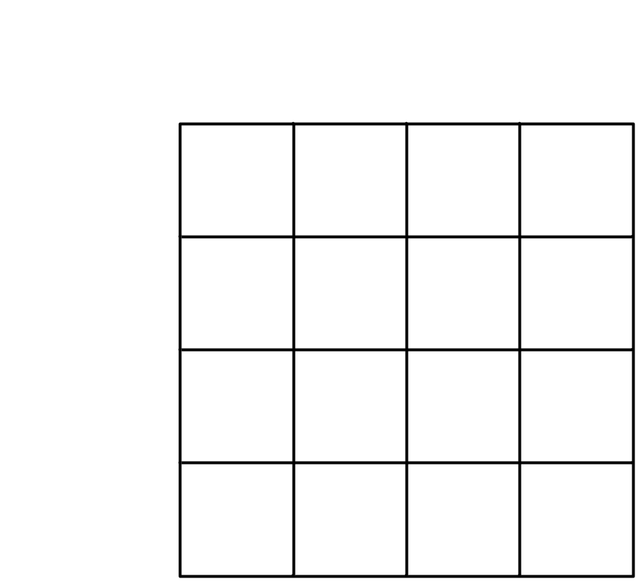
Adjacencies on three- and four-variable maps
1
1
1
1
3 - <number>

Slide 13
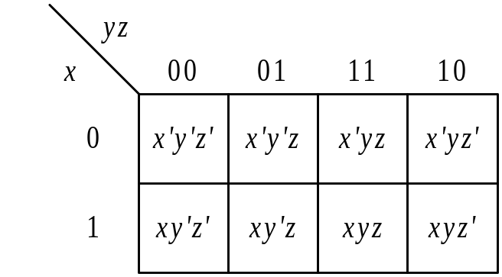
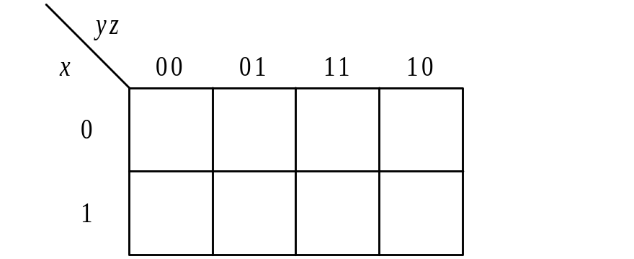
Three-variable map
(a) Map organization
x’y’
yz
z
x
xz’
(b) Example subcubes of size 4
(c) Example subcubes of size 2
3 - <number>

Slide 14
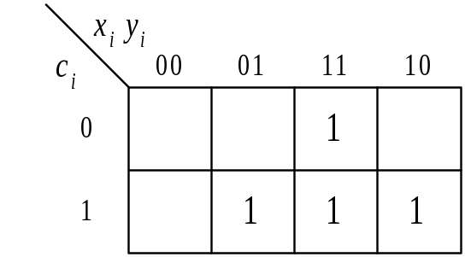
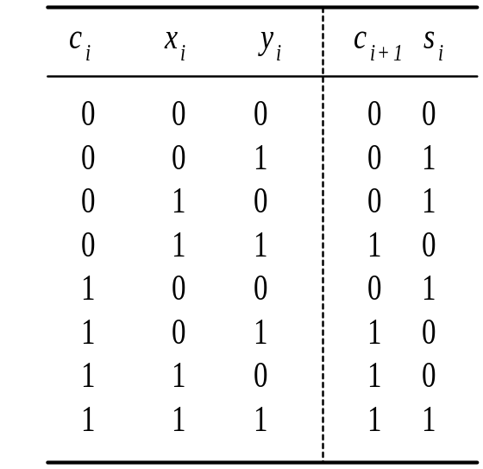
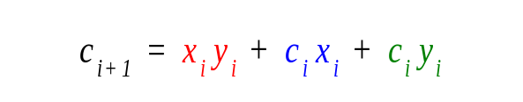
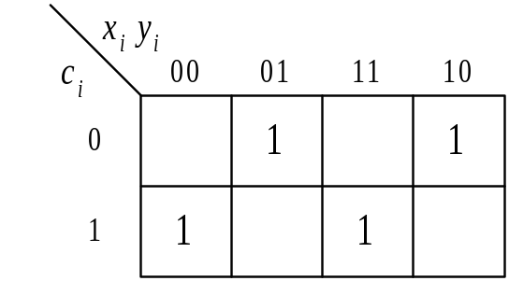
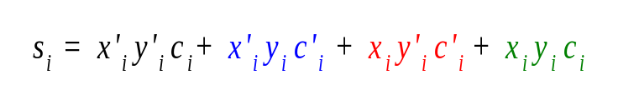
Map representation of carry and sum functions
(b) Carry function:
(a) Truth table
(c) Sum function:
3 - <number>

Slide 15
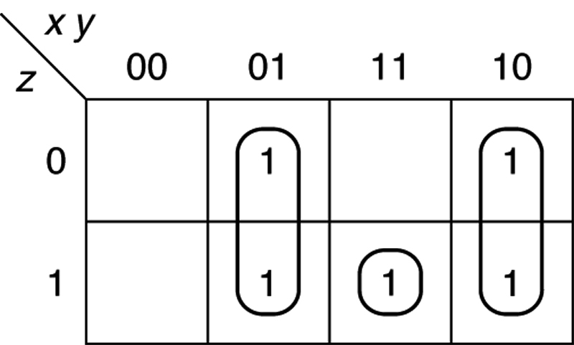
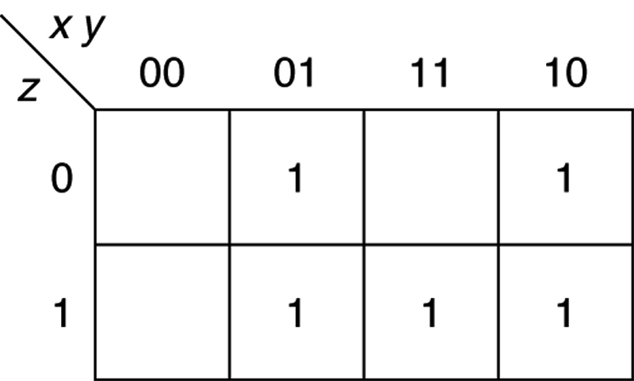
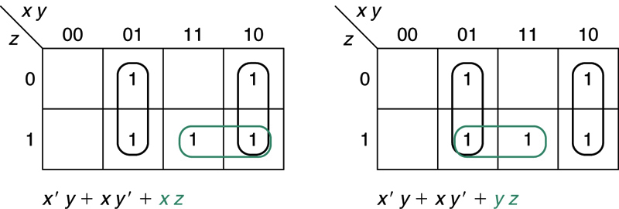
Example x ′yz ′ + x ′yz + xy ′z ′ + xy ′z + xyz.
3 - <number>

Slide 16
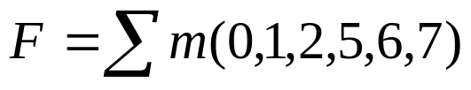
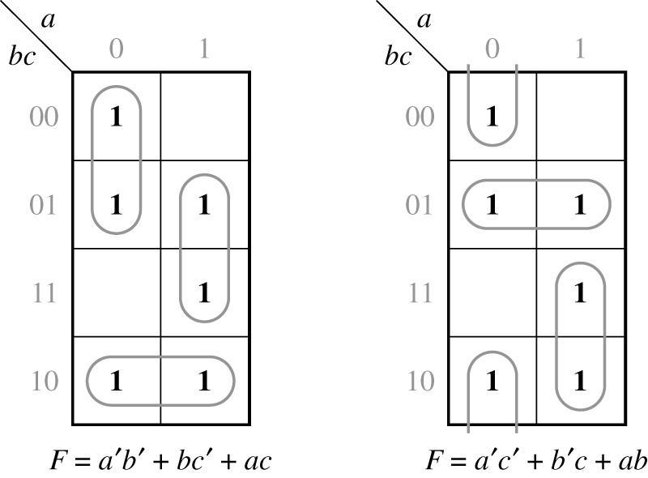
Example Function with Two Minimal Forms
3 - <number>

Slide 17
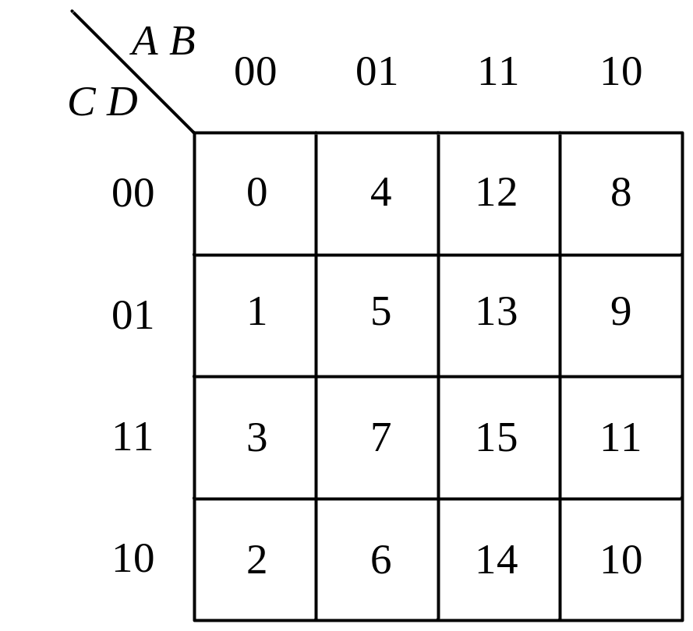
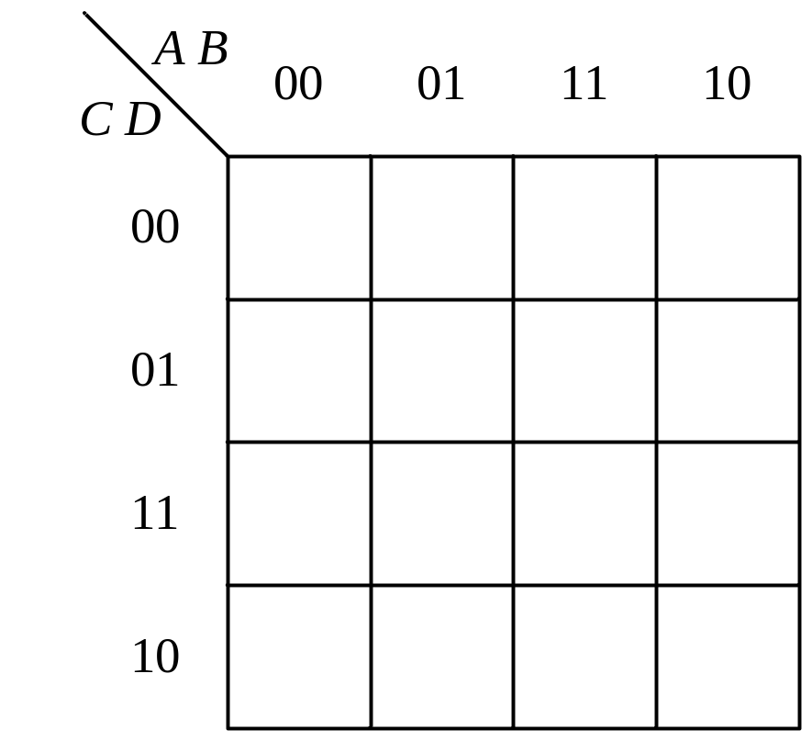
Four-variable Maps
A’B’C’D’
A’B C’D’
A B C’D’
A B’C’D’
A’B’C’D
A’B C’D
A B C’D
A B’C’D
A’B’C D
A’B C D
A B C D
A B’C D
A’B’C D’
A’B C D’
A B C D’
A B’C D’
3 - <number>

Slide 18
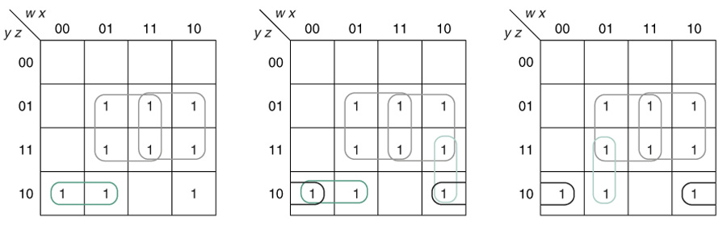
g(w, x, y, z) = Σm(2, 5, 6, 7, 9, 10, 11, 13, 15)
g = xz + wz + w′yz′ + wx′y
g = xz + wz + w′yz′ + x′yz′
g = xz + wz + x′yz′ + w′xy
3 - <number>

Slide 19
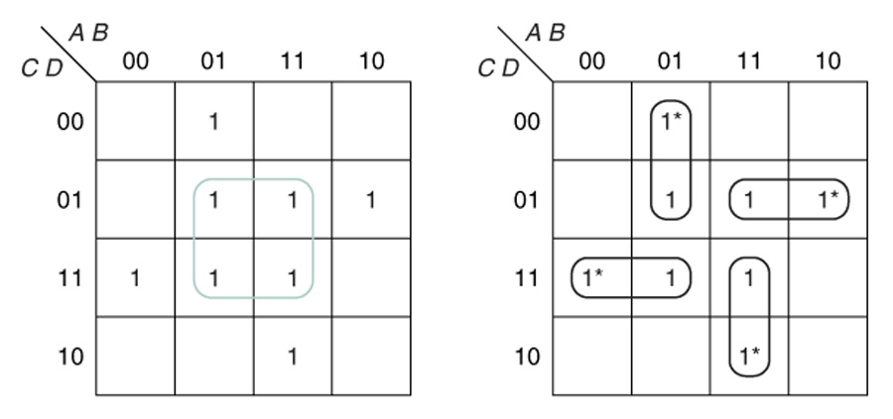
G = A′BC′ + A′CD + ABC + AC′D
3 - <number>

Slide 20

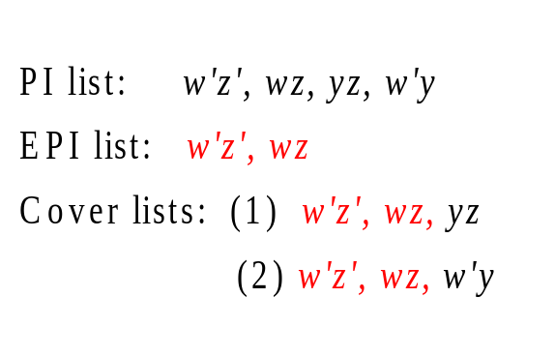
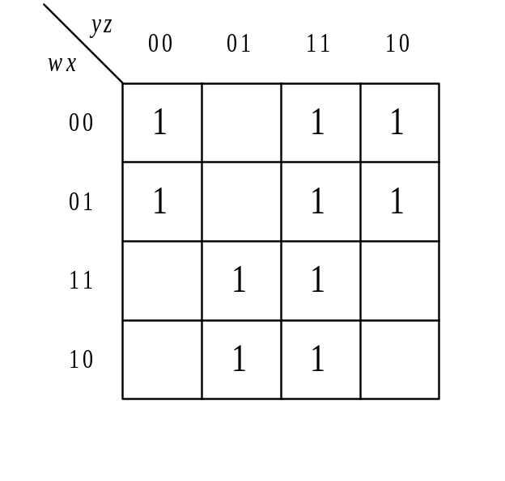
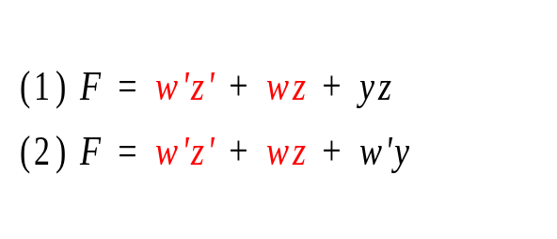
K-map example
(b) PI, EPI, and cover lists
w’y’z’
wz
xyz
w’y
w’z’
wz
yz
w’y
PIs
(c) Two functional expressions
(a) Prime implicants in the map
3 - <number>

Slide 21
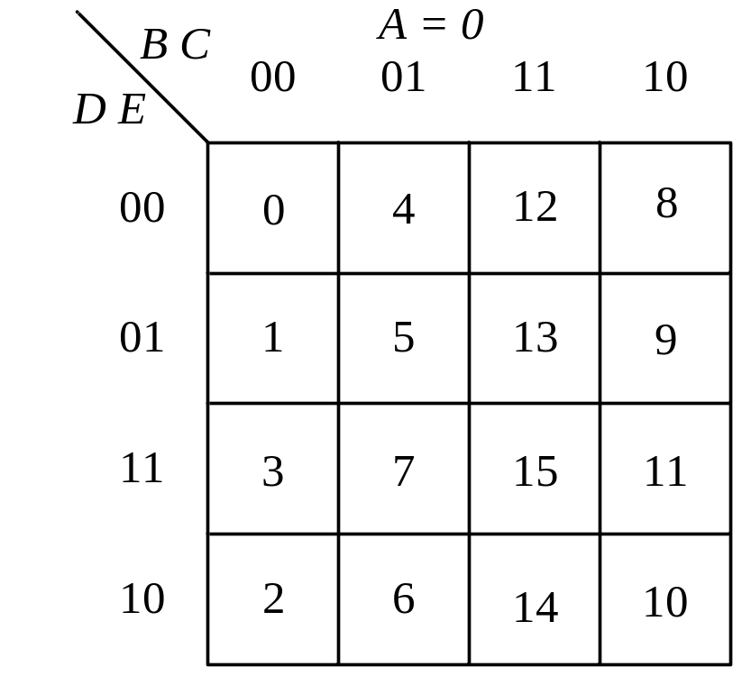
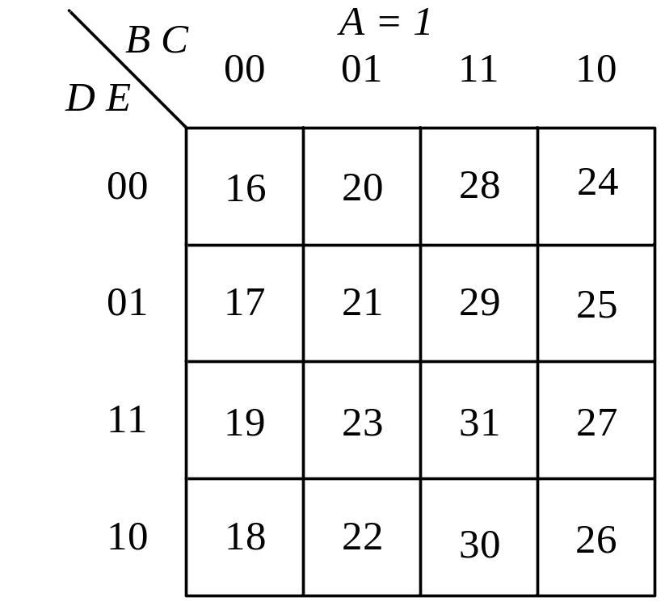
A Five Variable Map
A five-variable map consists of 2⁵ = 32 squares
3 - <number>

Slide 22
K-map with Don’t Cares
Sometimes a function table or map contains entries for which it is known:
  the input values for the minterm will never occur, or
  The output value for the minterm is not used
In these cases, the output value need not be defined
Instead, the output value is defined as a “don't care”
By placing “don't cares” ( an “x” entry) in the function table or map, the cost of the logic circuit may be lowered.
Example 1: A logic function having the binary codes for the BCD digits as its inputs. Only the codes for 0 through 9 are used. The six codes, 1010 through 1111 never occur, so the output values for these codes are “x” to represent “don’t cares.”
3 - <number>

Slide 23
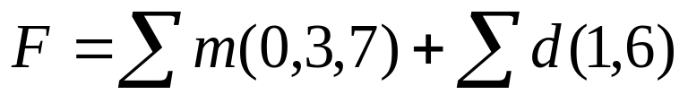

K-map with Don’t Cares
Minterm expansion for incompletely specified function
Don’t Cares
Maxterm expansion for incompletely specified function
3 - <number>

Slide 24
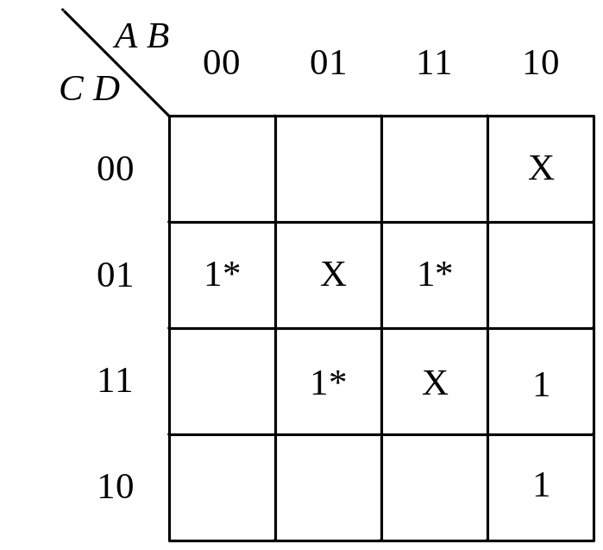
F(A,B,C,D) = ∑m(1,7,10,11,13) + ∑d(5,8,15)
  Minimum Solution
  F = BD + A’C’D + AB’C
  F = BD + A’C’D + (AB’D’ or ACD) are not used in the minimum solution
3 - <number>

Slide 25
A seven-segment display
a
b
c
d
e
f
g
W
a
f
b
X
Display Driver
g
Y
e
c
Z
d
3 - <number>

Slide 26
Truth table of seven segment display
Digit | W | X | Y | Z | a | b | c | d | e | f | g
0 | 0 | 0 | 0 | 0 | 1 | 1 | 1 | 1 | 1 | 1 | 0
1 | 0 | 0 | 0 | 1 | 0 | 1 | 1 | 0 | 0 | 0 | 0
2 | 0 | 0 | 1 | 0 | 1 | 1 | 0 | 1 | 1 | 0 | 1
3 | 0 | 0 | 1 | 1 | 1 | 1 | 1 | 1 | 0 | 0 | 1
4 | 0 | 1 | 0 | 0 | 0 | 1 | 1 | 0 | 0 | 1 | 1
5 | 0 | 1 | 0 | 1 | 1 | 0 | 1 | 1 | 0 | 1 | 1
6 | 0 | 1 | 1 | 0 | X | 0 | 1 | 1 | 1 | 1 | 1
7 | 0 | 1 | 1 | 1 | 1 | 1 | 1 | 0 | 0 | X | 0
8 | 1 | 0 | 0 | 0 | 1 | 1 | 1 | 1 | 1 | 1 | 1
9 | 1 | 0 | 0 | 1 | 1 | 1 | 1 | X | 0 | 1 | 1
- | 1 | 0 | 1 | 0 | X | X | X | X | X | X | X
- | 1 | 0 | 1 | 1 | X | X | X | X | X | X | X
- | 1 | 1 | 0 | 0 | X | X | X | X | X | X | X
- | 1 | 1 | 0 | 1 | X | X | X | X | X | X | X
- | 1 | 1 | 1 | 0 | X | X | X | X | X | X | X
- | 1 | 1 | 1 | 1 | X | X | X | X | X | X | X
3 - <number>

